Slide 1

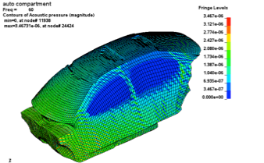

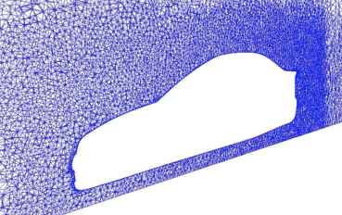
Block Low Rank Approximations in LS-DYNA
Cleve Ashcraft, Roger Grimes, Bob Lucas,
Francois-Henry Rouet, and Clement Weisbecker
June 2, 2017

Slide 2
Block Low Rank (BLR) approximations
Trades storage and operations for accuracy
  Storing low-rank approximations saves memory
  Computing with them saves operations and CPU time
  Clement’s thesis, implemented in MUMPS

Slide 3
Block Low Rank (BLR) approximations
Trades storage and operations for accuracy
  Storing low-rank approximations saves memory
  Computing with them saves operations and CPU time
  Clement’s thesis, implemented in MUMPS
Trade off ops and memory vs. accuracy

Slide 4
Multifrontal Solvers at LSTC
Multifrontal solvers are increasingly used in LS-DYNA
  BCSLIB-EXT World standard for shared memory
  mf2 Distributed memory/OpenMP
  MUMPS BLR and other research
We routinely solve tens of millions of equations
  Users want more
  Hundreds of millions, even billions
Today LS-DYNA runs on thousands of cores
  Users want more
  “… the current code is limited to 4096 processes so I cannot run the job up to the 96k cores I wanted to.”

Slide 5
Outline
BLR prior art
Segments
FSUC results
Impact on LS-DYNA

Slide 6
This is not our first look at BLR
BLR for multifrontal considered in the last millennium
  No segments
LSTC investigated in the last decade
  Implemented FSUC in mf2 to compute storage reduction
  Segments derived from the elimination tree and initial matrix
  Absolute tolerance for BLR
  Preconditioned Conjugate Gradients
Reducing storage to stay in-core would be worthwhile
  Non-linear and eigenvalue solvers use lots of triangular solves

Slide 7
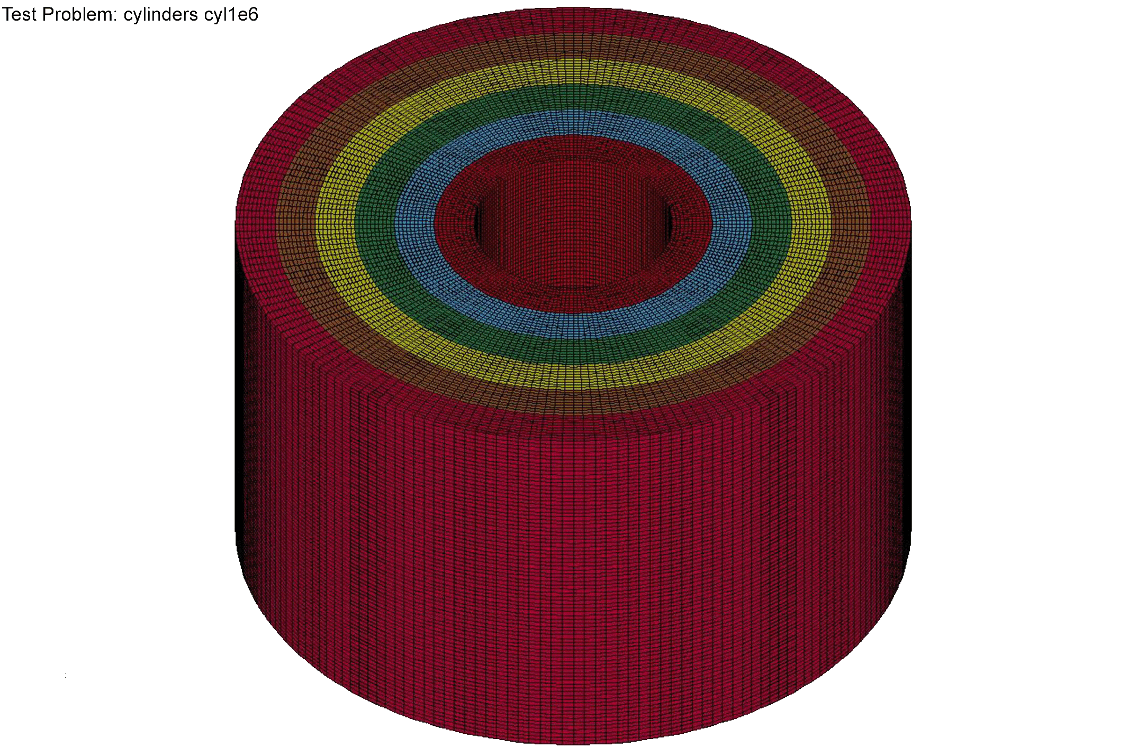
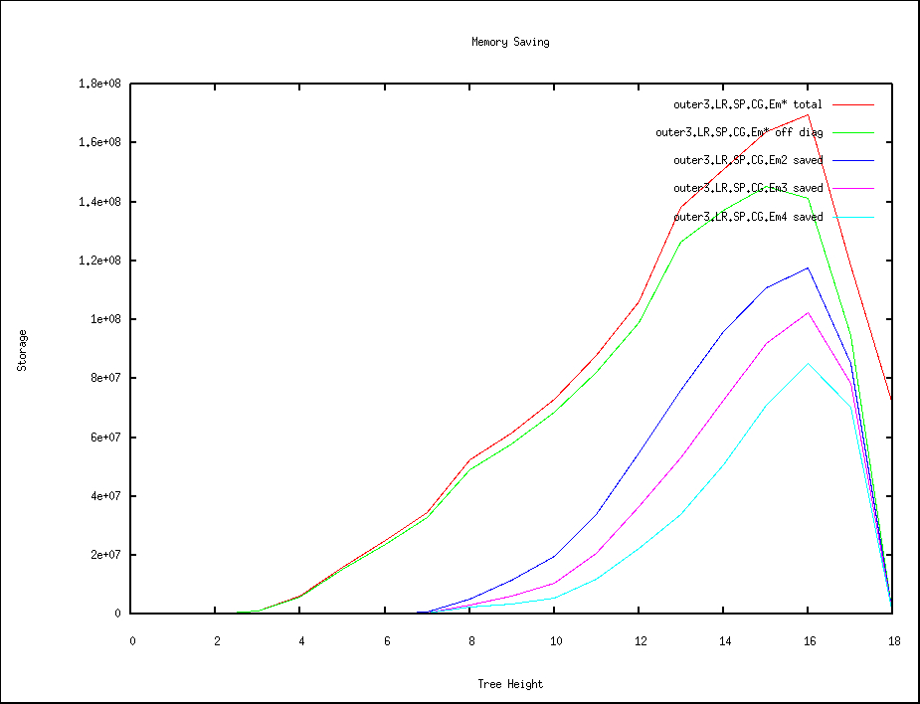
Compression vs. tree height – encouraging

Slide 8
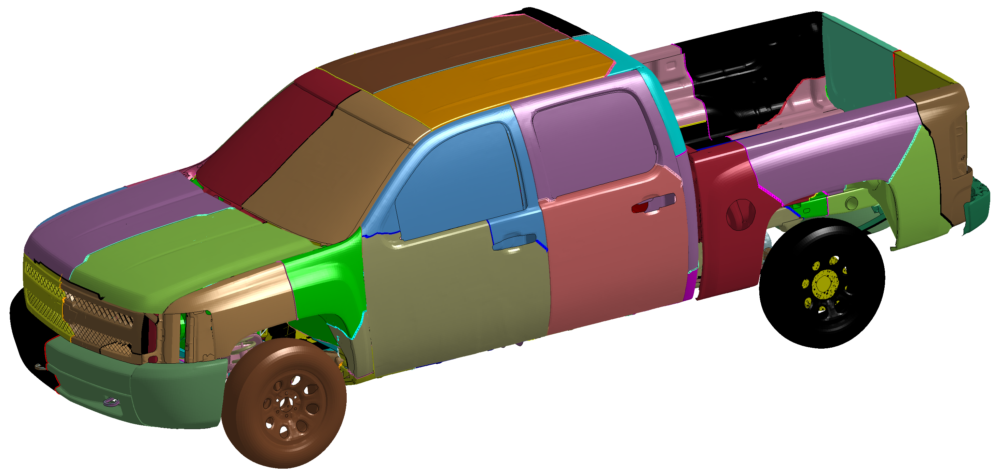
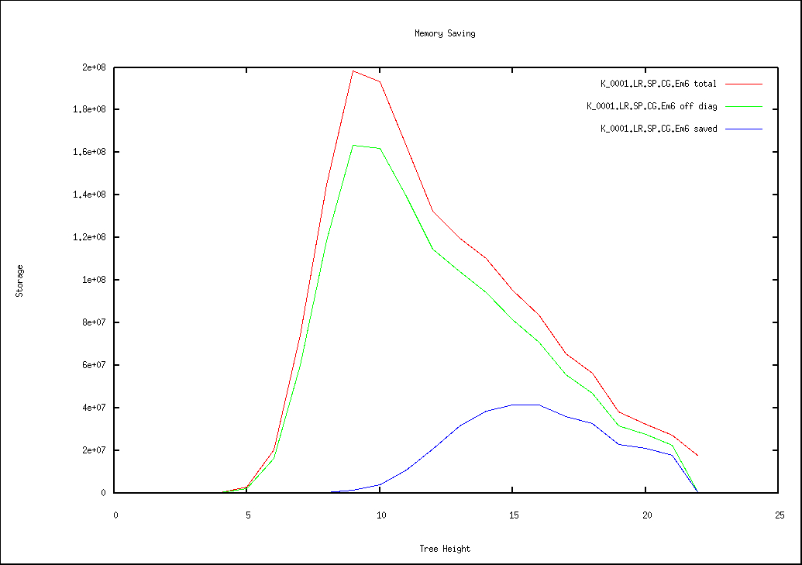
Compression vs. tree height – not so encouraging

Slide 9
Why I gave up the last time around
10
Sec.
4
8T 1T OOC SP E-6

Slide 10
MUMPS BLR results demand another look …
Richer set of segments
Relative tolerance
  MUMPS scales the initial matrix
  Tolerance relative to diagonal block
More sophisticated iterative solvers available
  Indefinite problems
  Block shift invert eigensolver

Slide 11
Outline
BLR prior art
Segments
FSUC results
Impact on LS-DYNA

Slide 12
Elimination tree segments (any ordering)

Slide 13
Elimination tree segments (any ordering)

Slide 14
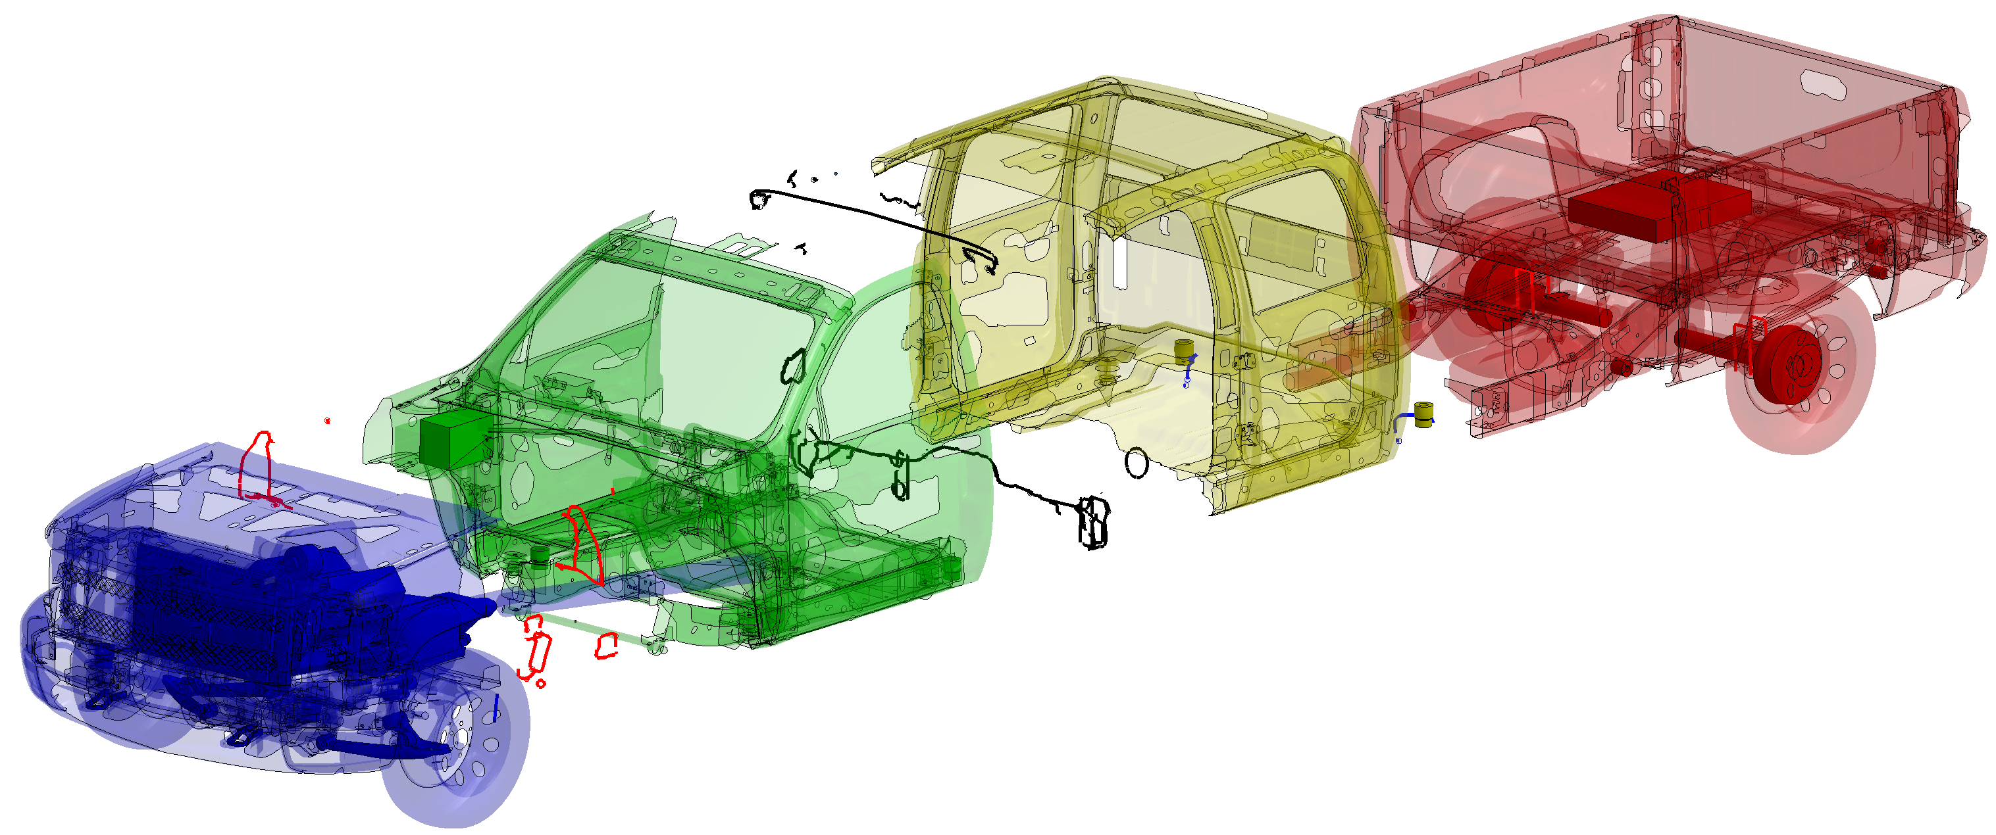
LS-GPart nested dissection
LSTC’s nested dissection algorithm
  Uses level-sets from multiple pseudo-peripheral nodes
  Cleve Ashcraft and Francois-Henry Rouet

Slide 15
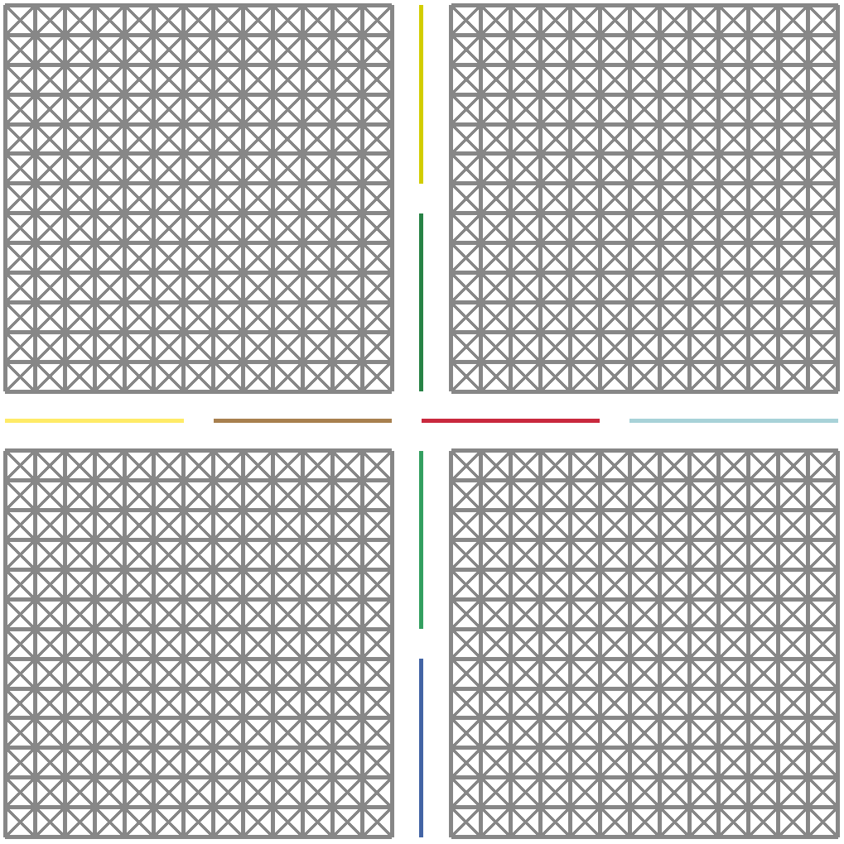
Segments from LS-GPart nested dissection

Slide 16
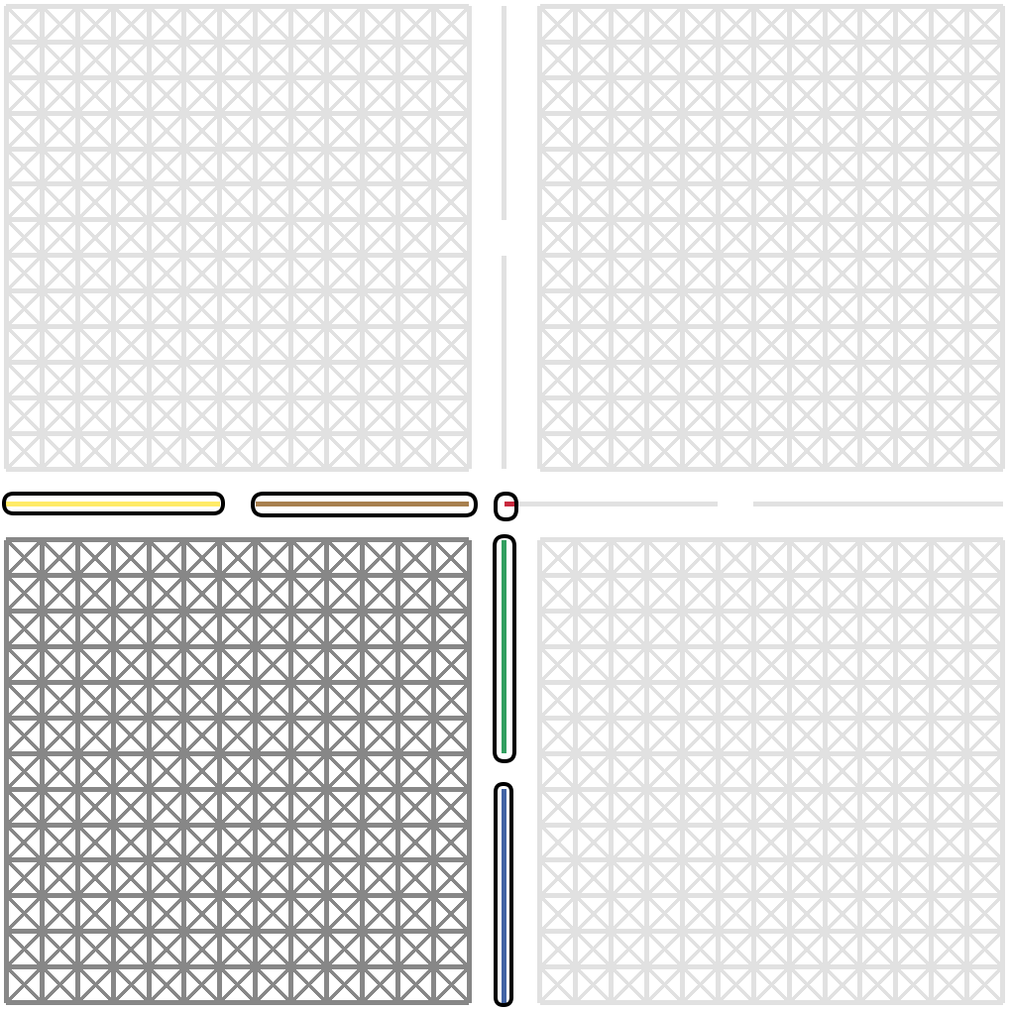
Segment fragments

Slide 17
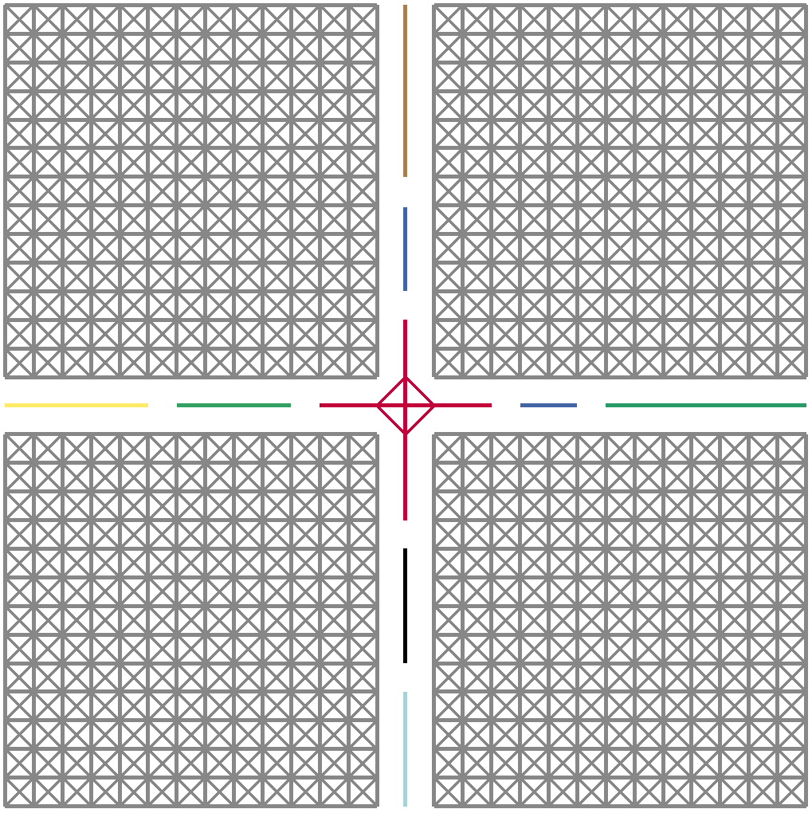
LS-Gpart “wire basket” segments

Slide 18
Impact of different segments
Work in progress
  Need better metrics for evaluating quality
Numbers from last week
  Arbitrary blocking 82%
  etree segments 40%
  LS-Gpart 36%
  LS-Gpart wire 39%*
  * Found two bugs on Wednesday ☹
Why is LS-GPart only marginally better?

Slide 19
Outline
BLR prior art
Segments
FSUC results
Impact on LS-DYNA

Slide 20
FSUC storage vs. BLR threshold

Slide 21
FSUC error norm vs. storage

Slide 22
FSUC norm of error vs. storage
Why not horizontal?

Slide 23
Outline
BLR prior art
Segments
FSUC results
Impact on LS-DYNA

Slide 24
Iterations for non-linear convergence

Slide 25
Final energy

Slide 26
Summary
Block Low Rank approximations are encouraging
  FSUC integrated into development version of LS-DYNA
  Non-MPI frontal matrices for now
Implementing FSCU now, then plan on FCSU
  Focused on understanding end-to-end impact on implicit finite element problems
MPI/OpenMP once overall impact better understood

Slide 27
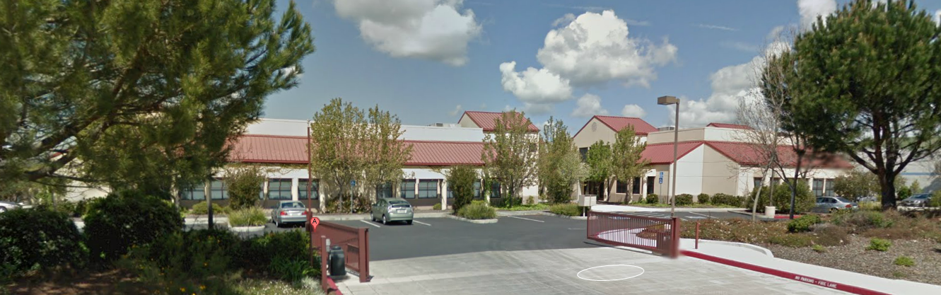

Thank you!
Notes:
27

